Slide 1
Computer Vision (2주차)
Young-Gon Kim
DLI Instructor

Slide 2
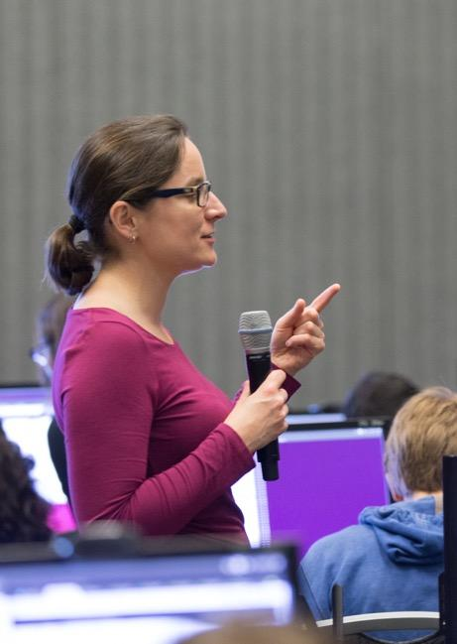
DEEP LEARNING INSTITUTE
DLI Mission
Helping people solve challenging problems using AI and deep learning.
Developers, data scientists and engineers
Self-driving cars, healthcare and robotics
Training, optimizing, and deploying deep neural networks
Notes:
People = Developers, Data Scientist, Engineers
Problems = Self-driving cars, healthcare issues like cancer detection, consumer services and robotics
AI / Deep Learning = training, optimizing and deploying deep neural networks

Slide 3
Week 1 Review
Overfitting
Big Data
Transfer Learning
TOPICS

Slide 4
WEEK 1 REVIEW

Slide 5
OVERFITTING

Slide 6
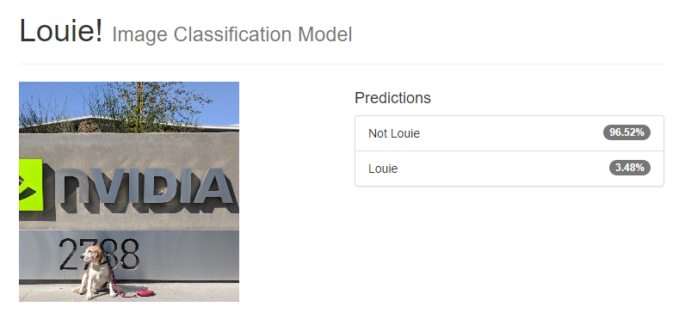
OVERFITTING

Slide 7
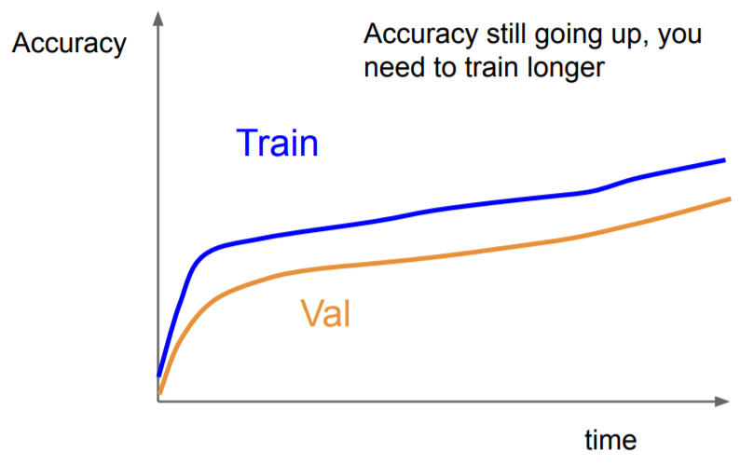
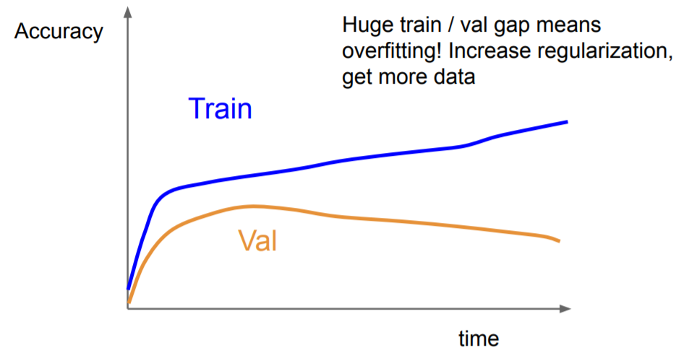
OVERFITTING
http://cs231n.stanford.edu/slides/2019/cs231n_2019_lecture08.pdf
Notes:
overfitting의 증상
Validation accuracy가 train accuracy를 계속 따라가면 계속 학습
Validation accuracy가 감소하기 시작되면 그 순간부터 overfitting

Slide 8
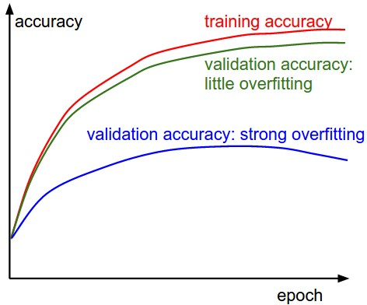
OVERFITTING
Type of ‘overfitting’
Green : little overfitting → Model capacity is not high enough!
Blue : strong overfitting → Model’s complexity is too high!
http://cs231n.github.io/neural-networks-3/
Notes:
Overfitting은 두가지 증상이 있음
Little overfitting
Validation accuracy가 train accuracy를 비슷한 수치로 계속 따라가면 model capacity가 부족함 → 모델을 더 깊게 만들어서 더 복잡하게 하면 해결 가능
Strong overfitting
Validation accuracy가 감소하기 시작하면 모델의 복잡도가 데이터셋에 비해 너무 높다고 할 수 있음 → 여러 해결방안이 있음

Slide 9

OVERFITTING
How to solve the ‘overfitting’?
Regularization
Early stopping
Dropout
http://cs231n.github.io/neural-networks-3/
Notes:
overfitting의 해결방안
Regularization
Early stopping
Dropout

Slide 10
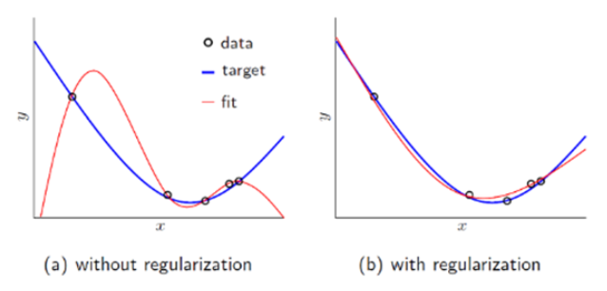
OVERFITTING
How to solve the ‘overfitting’?
Regularization
Loss function에 penalty term을 추가 (L1/L2 regularization)
Variance를 낮춰서 model의 complexity를 낮춤 (smoothing)
Early stopping
Dropout
$$L1 \text{regularization}=\frac{1}{n} \sum_{i=1}^{n}{\{L\left(y_{i}, {\hat{y}}_{i}\right)+\frac{λ}{2}\left|w\right|\}}$$
$$L2 \text{regularization}=\frac{1}{n} \sum_{i=1}^{n}{\{L\left(y_{i}, {\hat{y}}_{i}\right)+\frac{λ}{2}{\left|w\right|}^{2}}\}$$
https://nittaku.tistory.com/289
https://laonple.blog.me/220527647084
Notes:
overfitting의 해결방안
Regularization
Loss function에 penalty term 추가
모델의 variance를 낮춰서 fitting을 원할하게 만듬

Slide 11
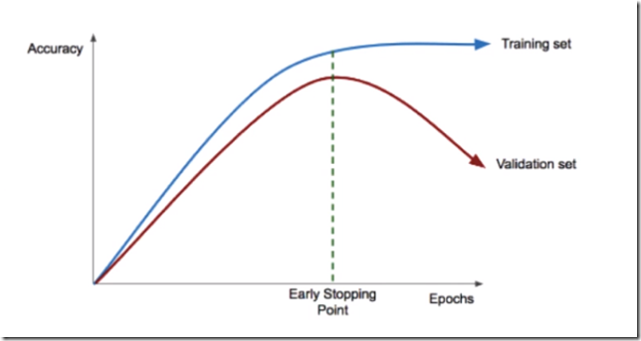
OVERFITTING
How to solve the ‘overfitting’?
Regularization
Early stopping
Validation set accuracy가 멈추거나 낮아지는 지점 존재
이 시점에서 학습 중지
Dropout
https://nittaku.tistory.com/289
Notes:
overfitting의 해결방안
Early stopping
Validation accuracy가 낮아지는 지점에서 학습 중지

Slide 12
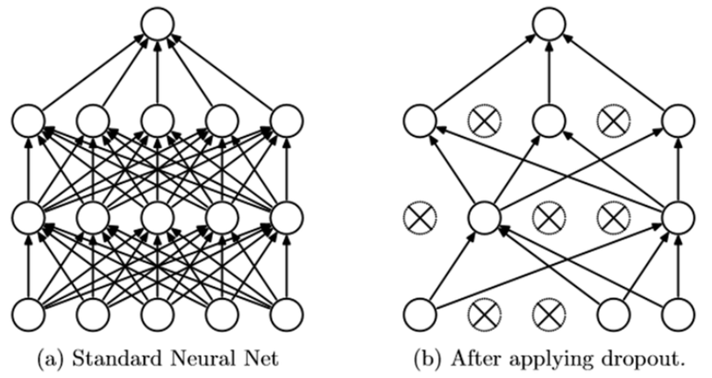
OVERFITTING
How to solve the ‘overfitting’?
Regularization
Early stopping
Dropout
Network의 일부를 생략하고 학습
Model ensemble 효과
https://laonple.blog.me/220542170499
Notes:
overfitting의 해결방안
Dropout
Network의 일부를 생략하고 학습 → model ensemble 효과

Slide 13
Training, Validation, Test

Slide 14
DATASET SPLIT
A Total of dataset
Training
Validation
Test

Slide 15
BIG DATA

Slide 16
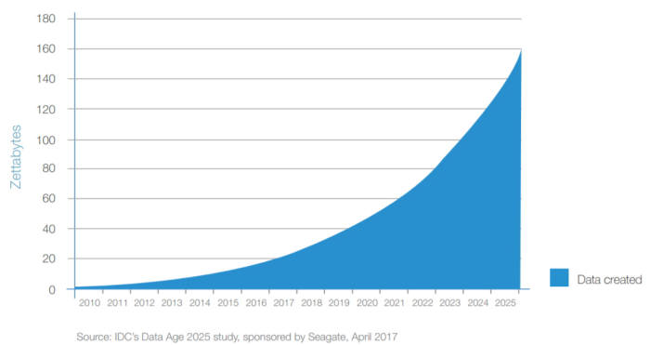
BIG DATA
https://m.etnews.com/20171128000218
Notes:
Data의 양이 기하급수적으로 증가하는 경향

Slide 17
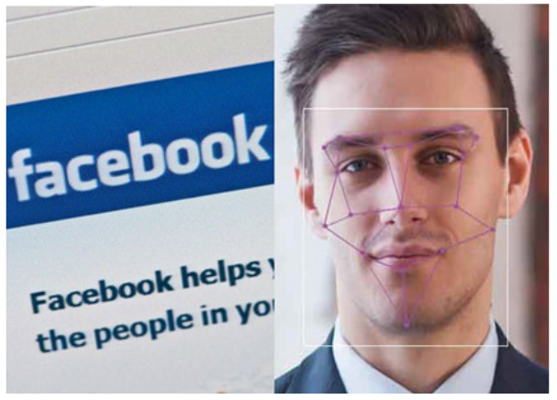
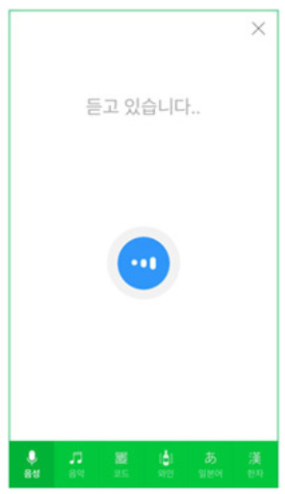
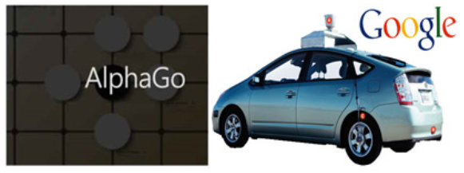
BIG DATA
Big data와 Deep learning
방대한 데이터를 다룰 수 있는 기술의 발전 → Deep learning의 발전에 큰 역할 → 우리 생활에서 큰 역할을 하기 시작
https://www.samsungsds.com/global/ko/support/insights/1196843_2284.html
Notes:
엄청난 양의 데이터를 다룰 수 있는 기술이 발전 → 많은 양의 데이터를 필요로 하는 딥러닝의 발전이 시작

Slide 18

BIG DATA
Examples about deep learning using big data
→ Dog & Cat classification
https://becominghuman.ai/building-an-image-classifier-using-deep-learning-in-python-totally-from-a-beginners-perspective-be8dbaf22dd8
Notes:
Dog & cat classification

Slide 19
Task 2 BIG DATA

Slide 20
DEPLOYMENT

Slide 21
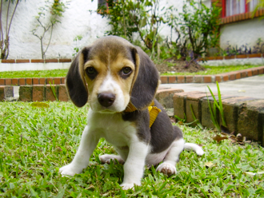
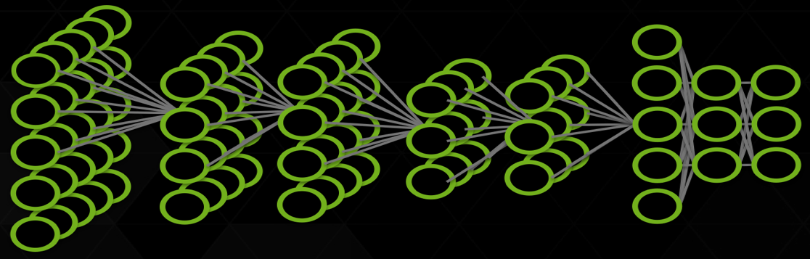


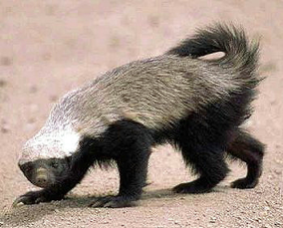

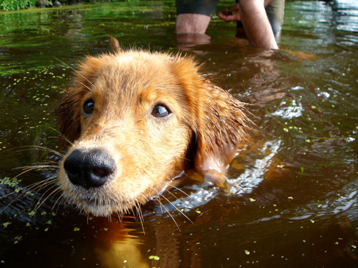
DEPLOYMENT
Deep Learning Approach
Errors
Train:
Dog
DNN
Dog
Cat
Cat
Raccoon
Honey badger
Deploy:
DNN
Dog
Notes:
딥러닝 모델의 구조
네트워크가 입력에 대한 결과를 도출하면
결과에 대한 에러를 네트워크에 반영
추후에 정답을 맞출 수 있도록 학습 진행

Slide 22
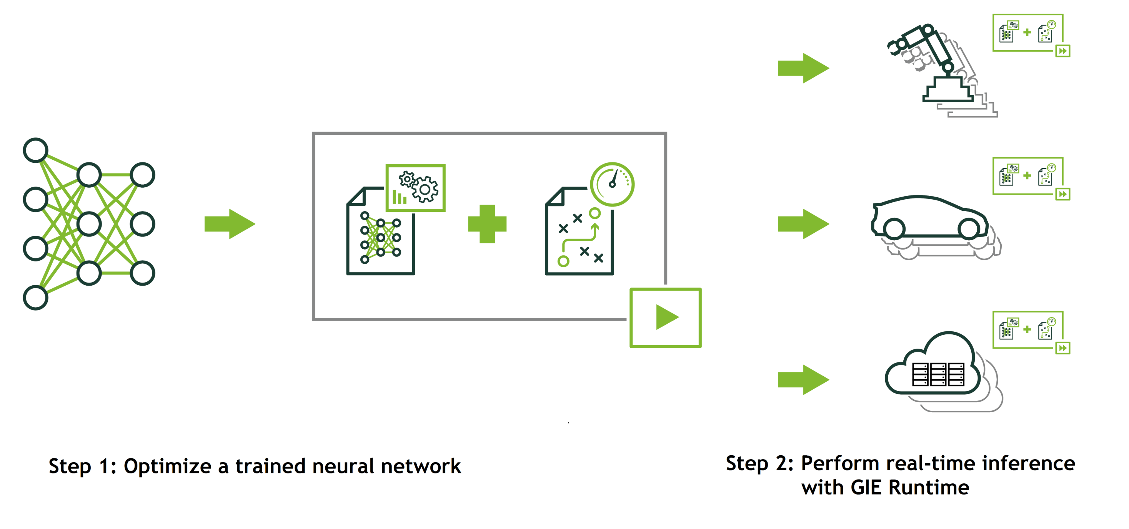
DEPLOYMENT
How do I use a trained neural network as part of a solution?

Slide 23
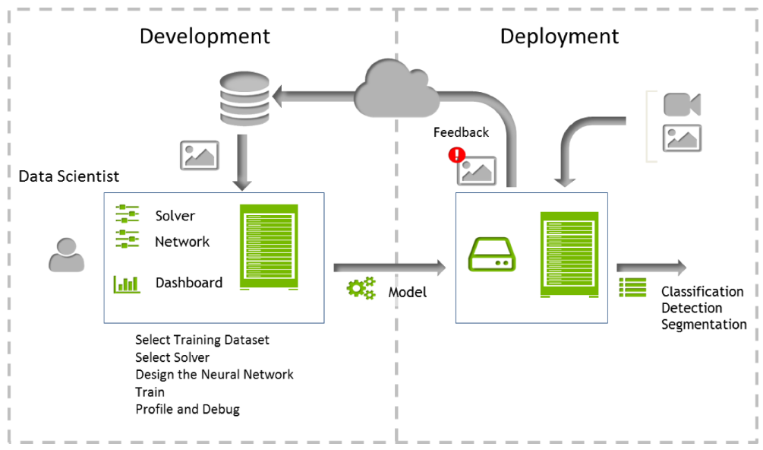
DEPLOYMENT
Neural network training and inference

Slide 24
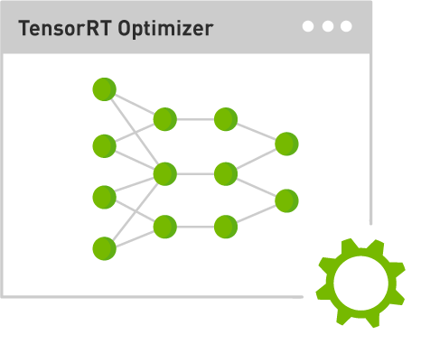

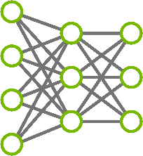

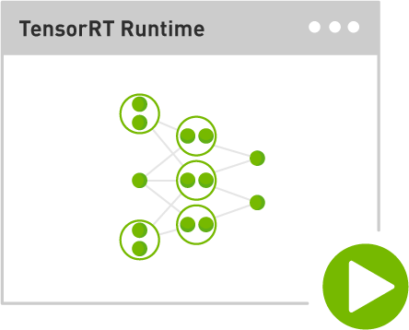
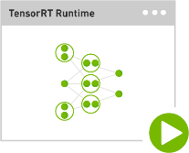

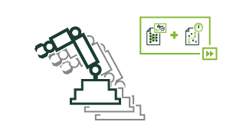
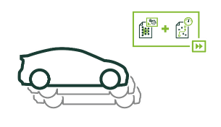
DEPLOYMENT
Step 1: Optimize trained model
Import
Model
Serialize
Engine
Plan 1
Plan 2
Plan 3
Trained Neural Network
TensorRT Optimizer
Optimized Plans
Step 2: Deploy optimized plans with runtime
Plan 1
De-serialize
Engine
Deploy
Runtime
Plan 2
Data center
Plan 3
Optimized Plans
TensorRT Runtime Engine
Automotive
Embedded

Slide 25
Task 3 DEPLOYMENT

Slide 26
TRANSFER LEARNING

Slide 27
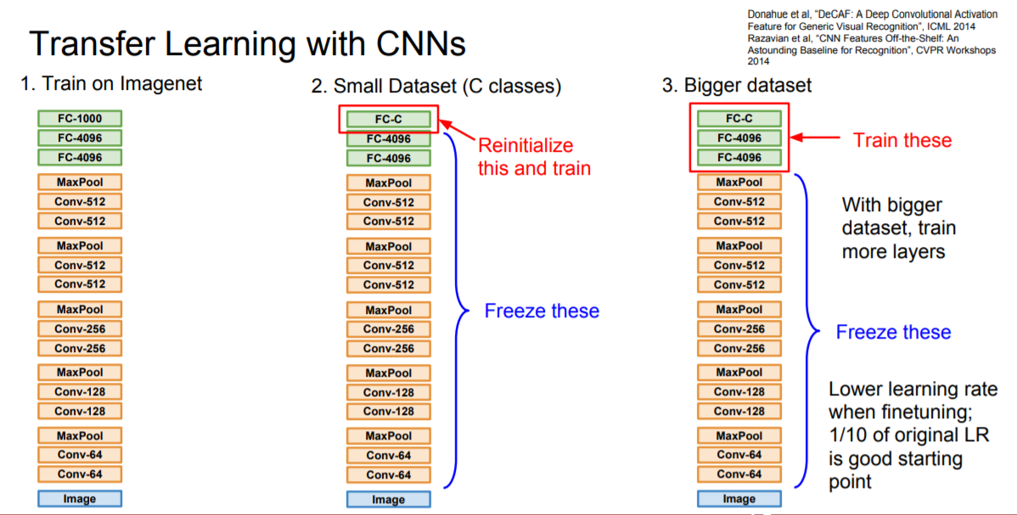
TRANSFER LEARNING
Why do we use “transfer learning”?
충분한 양의 데이터를 갖고 있기가 쉽지 않음
다른 사람들이 미리 학습한 모델을 이용
Major types of transfer learning
ConvNet as fixed feature extractor
Fine-tuning the ConvNet
Pretrained models
http://cs231n.github.io/transfer-learning/
http://cs231n.stanford.edu/slides/2018/cs231n_2018_lecture07.pdf
Notes:
Transfer learning
문제를 해결하기 위한 모델을 학습할 때 데이터가 부족한 경우가 많음
다른 사람들이 미리 학습한 모델을 사용하는 경우가 있음
종류
Pretrained Convnet을 feature extractor로 이용
ConvNet을 fine tuning
Pretrained ConvNet 그대로 이용

Slide 28
TRANSFER LEARNING
Major types of transfer learning
ConvNet as fixed feature extractor
Pretrained된 ConvNet의 마지막 Fully-connected layer 제거
이 network를 new dataset의 feature extractor로 사용
new dataset에 대해 linear classifier 학습 (Linear SVM, Softmax classifier, …)
Fine-tuning the ConvNet
Pretrained models
http://cs231n.github.io/transfer-learning/
Notes:
종류
Pretrained Convnet을 feature extractor로 이용
Pretrained convnet의 마지막 fc 제거
Fc가 제거된 network를 feature extractor로 사용
New dataset으로 추출한 feature로 linear classifier 학습

Slide 29
TRANSFER LEARNING
Major types of transfer learning
ConvNet as fixed feature extractor
Fine-tuning the ConvNet
Classifier on top of the ConvNet을 new dataset에 대해 replace & retrain
Fine-tune the weights of the pretrained network by continuing the backpropagation
Fine-tune all the layers of the ConvNet
Keep some of the earlier layers fixed
Fine-tune some higher-level portion of the network
Pretrained models
http://cs231n.github.io/transfer-learning/
Notes:
종류
ConvNet을 fine tuning
ConvNet의 Classifier를 new dataset에 대해 교체 및 재학습
모든 layer를 fine tuning
이전 layer들은 fix
몇몇 부분만 fine tuning

Slide 30
TRANSFER LEARNING
Major types of transfer learning
ConvNet as fixed feature extractor
Fine-tuning the ConvNet
Pretrained models
- ImageNet으로 미리 학습한 모델 사용
http://cs231n.github.io/transfer-learning/
Notes:
종류
Pretrained ConvNet 그대로 이용
imagenet으로 pretrain된 모델을 그대로 사용

Slide 31
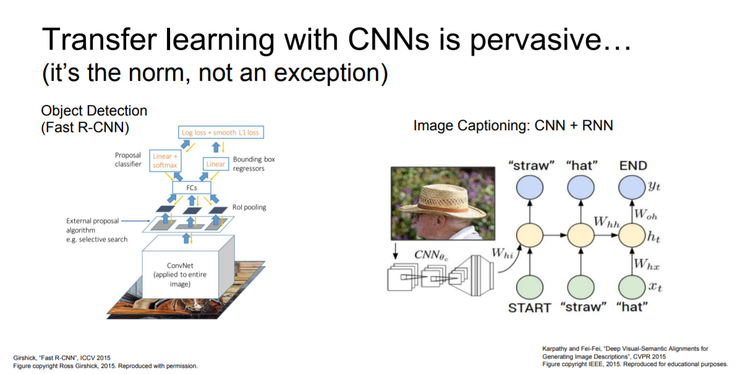
TRANSFER LEARNING
Examples of transfer learning
CNN pretrained on ImageNet
Word vectors pretrained with word2vec
http://cs231n.github.io/transfer-learning/
Notes:
Transfer learning 예시
Feature를 추출하기 위해 pretrain된 모델을 사용

Slide 32
Reference
http://cs231n.stanford.edu/slides/2019/cs231n_2019_lecture08.pdf
http://cs231n.github.io/neural-networks-3/
https://nittaku.tistory.com/289
https://laonple.blog.me/220527647084
https://laonple.blog.me/220542170499
https://m.etnews.com/20171128000218
https://www.samsungsds.com/global/ko/support/insights/1196843_2284.html
https://becominghuman.ai/building-an-image-classifier-using-deep-learning-in-python-totally-from-a-beginners-perspective-be8dbaf22dd8
http://cs231n.github.io/transfer-learning/
http://cs231n.stanford.edu/slides/2018/cs231n_2018_lecture07.pdf

